Slide 1
David Bearfield, Director European Personnel Selection Office
ATP India 2017
Testing times ahead – trends and challenges for the testing community

Slide 2
EPSO's role is to serve the EU Institutions by providing high quality, efficient and effective selection procedures that enable them to recruit the right person, for the right job, at the right time."

Slide 3
About EPSO
10 EU Institutions and many EU Agencies
28 EU countries
24 official languages
542,000 applications since 2010
7377 successful candidates since 2010

Slide 4
Global Shifts - picture:
Notes:
David
Currently being impacted by multiple, global shifts simultaneously. These shifts are potentially major, individually any one has the capacity to herald the shift to a new epoch in human development. Taken together, the disruptive effect will be huge – with positive and negative consequences:
Digital revolution – major shift from an analogue to a digital world
Globalisation – the need for a global perspective to everything we do, including the war for talent
Scientific progress – at an unprecedented speed in every area of human activity
Climate change
Generational change

Slide 5
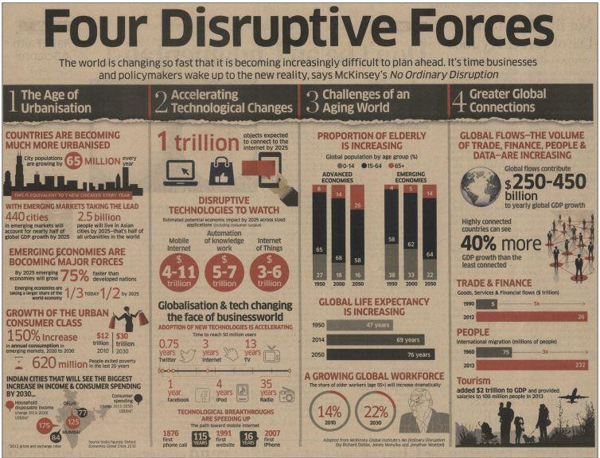

Slide 6
(Pictures!) Macro
Globalization
Digital Revolution
Climate Change
Notes:
Dawn
Currently being impacted by multiple, global shifts simultaneously. These shifts are potentially major, individually any one has the capacity to herald the shift to a new epoch in human development. Taken together, the disruptive effect will be huge –
with positive and negative consequences:
Digital revolution – major shift from an analogue to a digital world
Globalisation – the need for a global perspective to everything we do, including the war for talent
Scientific progress – at an unprecedented speed in every area of human activity
Climate change
Generational change

Slide 7
2017
Picture of a cliff edge?
Notes:
David
In 2017, we stand on the cusp of another epoch. There are different political responses to the challenges we face and we can see those falling broadly into two categories: progressive and regressive. The regressive see these changes more as a threat than an opportunity, and seek to deny their existence and go back to an often mythologised vision of an early age: Trump/Brexit. The progressive see changes as more of an opportunity than a threat and seek to harness them to enable society to develop in a positive way: Obama, Macron.
There are many examples of how this will impact industry: the decline of traditional industries/shift to on-line (for example in retail)/shift from fossil fuels to renewables

Slide 8
Key challenges
EUROPE

Slide 9
Challenges in recruiting the next generations
War for Talent
VUCA World
Demographic Shift
Generational Shift

Slide 10
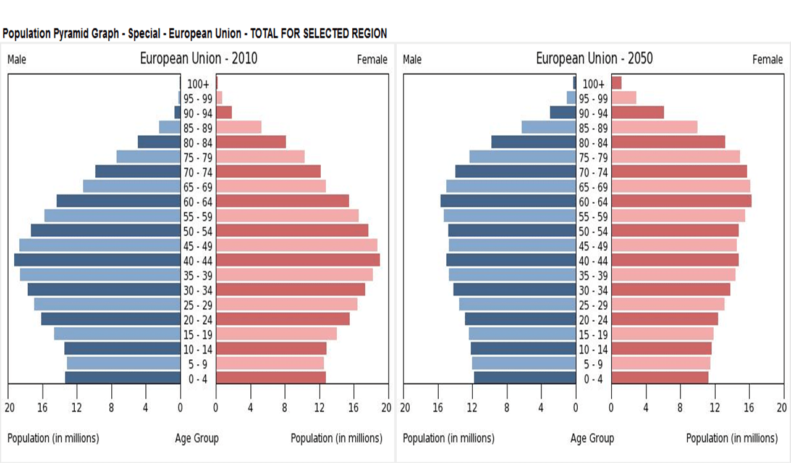
Demographic shift
Baby boomers are retiring;
Ageing population means there will be growing skills and talent shortages.

Slide 11
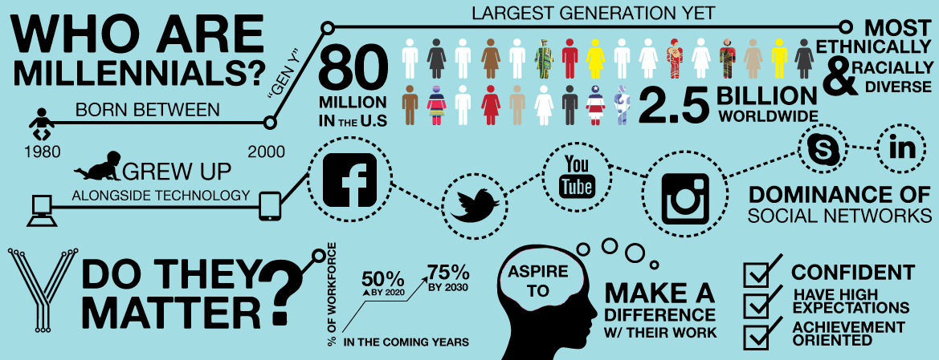
Generational shift
The workforce that will replace them has very different expectations of employers and employment;
Millenials have little interest in a traditional single-employer career.

Slide 12
The baby boom generation will soon be replaced by the iGeneration

Slide 13
What do Millennial Employees Want?

Slide 14
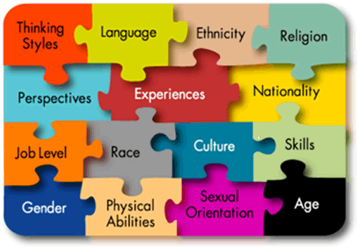
War for talent
Increasingly sharp competition for talent.
Greater diversity
Expectations that public sector bodies reflect the diversity of the citizens they serve;
Diversity of thought and talent important in coping with rapid change.
The war for talent is over. And talent won."
”Talentism is the new Capitalism.”
Klaus Schwab, Founder & Executive Chairman, World Economic Forum

Slide 15
Key challenges
INDIA

Slide 16
Seven challenges facing India – according to the WEF
Education and skills
Urbanisation
Health
Sanitation
Gender
Water security
Transparency

Slide 17
India's demographic opportunity

Slide 18
Share of world's college graduates – USA, China and India

Slide 19
Looking ahead

Slide 20
EDUCATION

Slide 21
Assessment for education and employment

Slide 22
Spot the problem…
Whilst technology has evolved, education of our children is frighteningly stuck in the past

Slide 23
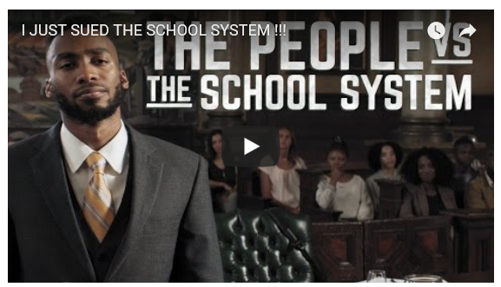

Slide 24
Learning and assessment – no longer something you solely do at school

Slide 25
Democratisation of access to information via MOOCs
In 2016, 2,600+ new courses were announced, taking the total number of courses to 6,850 from over 700 universities;
In the past three months alone, over 200 universites have announced 600 free online courses!

Slide 26
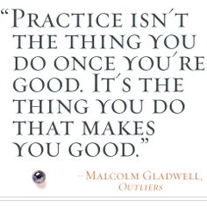
Is academic achievement a predictor of success?

Slide 27
Challenges and impact on the testing community

Slide 28
For Schools
Individualisation of the learning experience
Technology as the main vehicle for learning
Teacher as coach and guide, not disseminator of information
Testing will be embedded in the learning process, rather than a memory test at the end
For higher education
- Consumerisation of higher education
Rapid growth of MOOCs
Major opportunity for certifying what knowledge/skills have been acquired online

Slide 29
WORKPLACE

Slide 31
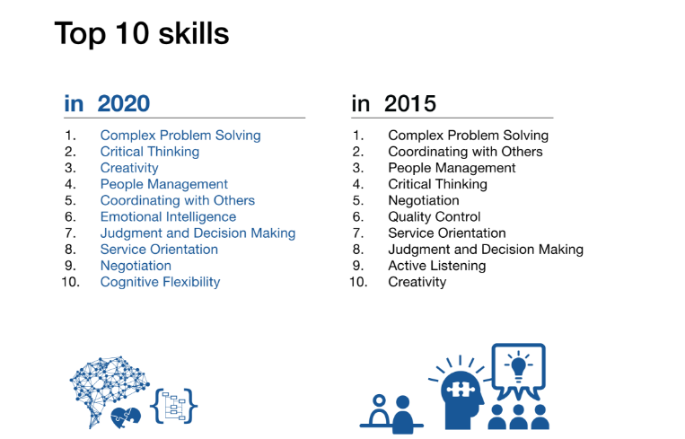
Shift in Desired Skills
Source: Future of Jobs Report, World Economic Forum
Notes:
David Last Slide

Slide 32
Source: Manpower Group Talent Shortage Survey 2016/2017

Slide 33
Challenges and impact on the testing community

Slide 34
Rapid technological and scientific progress means skills quickly become oudated;
Lifelong learning becomes a reality for most;
Major opportunity for re-testing and ongoing certification.

Slide 36
Recruitment based on skills rather than knowledge and diplomas
Ability to create immersive experience-based assessment, simulating the working environment and testing knowledge, competences and soft skills in parallel;
Use of computer-based and internet-based testing to drive down cost.

Slide 37
Challenges in Civil Service EUROPE

Slide 38
OECD report Skills for a High Performing Civil Service
Skills required in four areas:
Policy analysis and advice;
Service delivery and citizen engagement;
Commissioning and contracting;
Managing networks.

Slide 39
OECD report Skills for a High Performing Civil Service
Civil servants will require generic skills as well as technical skills – particularly in communciation, digital literacy and interpersonal skills;
We need to better understand the bundle of incentives that motivate people to serve the public.

Slide 40
OECD report Skills for a High Performing Civil Service
Future competencies:
Creative thinking (creativity and innovation);
Flexibility (flexibility and change management);
Co-operation (working collaboratively across boundaries and building relationships);
Strategic thinking (vision and future orientation).

Slide 41
Public sector - context
Changing dynamics of a world in transition - economic, political, technological and demographic – against this backdrop we face stiff competition for top talent;
Public sector organisations face highly challenging period in attracting and identifying the right talent to shape, drive and develop their work;
Retirement of an entire generation of civil servants over next 10 years = real need to address succession planning;
Traditional attraction package of the public sector being questioned by the political level and also by new generation of job seekers;
All these forces are making global public sector to rethink and redefine itself. Need for different mindset of people: question = how does the sector remodel and what exactly is the profile of those we need to take the it forward?

Slide 42
Challenges in Civil Service INDIA

Slide 43
Civil services examination - process
Consists of 3 stages and considered one of the most difficult and competitive with an average of 900,000 to 1,000,000 candidates applying per year;
Number taking the preliminary examination is @ 450,000
Stages:
1. Preliminary examination
2. Main examination
3. Personality test (interview)

Slide 44
Civil services examination – Vacancies and selection
Number of vacancies varies every year;
2006: @ 400,000 candidates applied for fewer than 500 vacancies, of which 7,500 passed the preliminary exam!

